Slide 1
Molecular Biology Biol 480
Lecture 16 February 25th, 2019

Slide 2
Announcements/Assignments
Keep reviewing lectures every day. Use the lecture summary tool, if it works for you.
Exam 2 March 4th.

Slide 3
Where were we?
TRANSCRIPTION
How is it similar to replication?
How is it different?
Define “gene”/ “cistron”
What is an ORF
---RNA polymerase and promoters.
Starting with E. coli

Slide 4
Since there is little coverage of the basics of transcription in your text---let’s back up to define the 2 basic players in transcription:
The gene---The DNA which provides the template for RNA polymerase to synthesize a complementary RNA molecule.
The proteins (like RNA polymerase) that find the gene and facilitate some aspect of transcription.

Slide 5
Similar to the origin of replication, DNA sequences making up the gene play a role in getting the gene transcribed. Among the most important, is a sequence called the promoter.
Basic structure of a gene….on board

Slide 6
RNA polymerase binds the promoter, which is located near the start site for transcription.
RNA polymerase usually needs assistance in locating and binding the promoter.

Slide 7
The mechanism of transcription
“Who” taught us about transcription? E. coli of course!
Much of the research that lead to the description of the central dogma of molecular biology came from studies using E. coli and the viruses (bacteriophages) that infect E. coli.

Slide 8
For example…
Base composition studies of E. coli following infection with bacteriophages suggested phage DNA was changed into phage RNA.
Table 13.6
Hybridization studies confirmed that RNA produced in cells was complementary to a DNA template.

Slide 9
RNA polymerase
A unique enzyme was isolated from rat liver in 1959 by Samuel Weiss which showed the same general requirement (DNA template) as DNA polymerase but which produced RNA.
Unlike DNA polymerases…this enzyme required no primer. It was able to like ribonucleotides directly de novo.

Slide 10
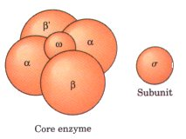
RNA polymerase
Biochemists turned back to E. coli to study the enzyme in detail.
RNA polymerase is a complex of 5 protein subunits
α (2 of these)
β
β’ actual polymerase activity
ω
σ

Slide 11
The α and ω subunits assist in assembling the whole complex---called the holoenzyme.
The σ subunit is also called the σ factor and is essential for transcription initiation. It binds to the gene promoters.

Slide 12
There are several different σ factors made by E. coli, which differ slightly in amino acid sequence and shape. (see upcoming slide)
They have in common, the ability to bind specific sequence of E. coli genes. The sequence they bind is known as the gene promoter. (shown in yellow—next slide).

Slide 13
Structure of an E. coli gene….

Slide 15
Become familiar with the structure of prokaryotic genes, including the promoters.
Find the consensus sequences at -35 and -10.
What do these number designations mean?
What is +1?

Slide 16
Envision how this works…

Slide 17
Many genes are bound by RNA pol with a common σ factor, called σ ⁷⁰
Recall, there is some variation in promoter sequence. E. coli makes different σ factors which bind variations on the -35 and -10 sequence.

Slide 18
Recall this slide…identify the 2 parts of the picture.
1
2

Slide 19
Transcription in all organisms involves 2 basic types of elements.
1. The protein (non-DNA) elements. At a minimum, the proteins making up RNA pol. Usually some set of accessory proteins (transcription factors). We call these the trans elements.
2. The DNA sequences that bind RNA pol and transcription factors are called the cis elements.
We will refer to these different types of elements frequently from this point on.

Slide 20
Transcription in prokaryotes
Once it has recognized and bound a promoter transcription can be initiated by RNA polymerase.
The first NTP , complementary to the +1 nucleotide in the template strand is linked to the next complementary NTP, creating a di-ribonucleotide (a 2-nucleotide RNA).
**An important difference from replication is that one strand is used as template. The other stands by!

Slide 21
Non-coding strand
Coding strand

Slide 22
Sense strand refers to the fact that this strand holds the actual sequence of the RNA molecule.
Be sure to understand how to transcribe the RNA from the DNA.
A double stranded DNA molecule, written in text can have genes on either strand.

Slide 23
Viruses have to make the most of their small genomes. This cartoon shows how seven genes of a phage are arranged in a small region of its genome. All encode different proteins. (when we review the genetic code, you will remember how this is possible)
Figure 13.8
Notes:
Figure 14-8b Illustration of the concept of overlapping genes. (a) An mRNA sequence initiated at two different AUG positions out of frame with one another will give rise to two distinct amino acid sequences. (b) The relative positions of the sequences encoding seven polypeptides of the phage

Slide 24
Initiation continues until about 8 bases of RNA are synthesized. The RNA is bound by H-bonds to the DNA template, creating an RNA-DNA hybrid with the antisense strand.
At this point the σ subunit dissociates from the RNA polymerase complex and transcription enters the elongation phase.

Slide 25
Elongation
The elongation of the new RNA continues for the length of the DNA template, but only about only about 8 nucleotides of RNA remain attached to the DNA template at any given time. The rest of the newly made (nascent) RNA detaches from the template.
The DNA duplex reforms behind the growing RNA strand.

Slide 26
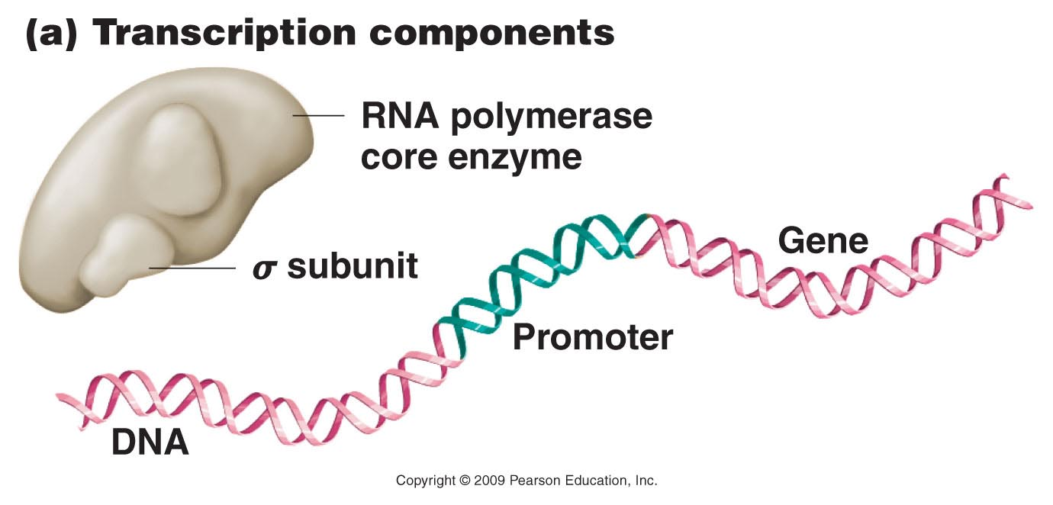
Figure 13.9a
Notes:
Figure 14-9a The early stages of transcription in prokaryotes, showing (a) the components of the process; (b) template binding at the –10 site involving the sigma subunit of RNA polymerase and subsequent initiation of RNA synthesis; and (c) chain elongation, after the sigma subunit has dissociated from the transcription complex and the enzyme moves along the DNA template.

Slide 27
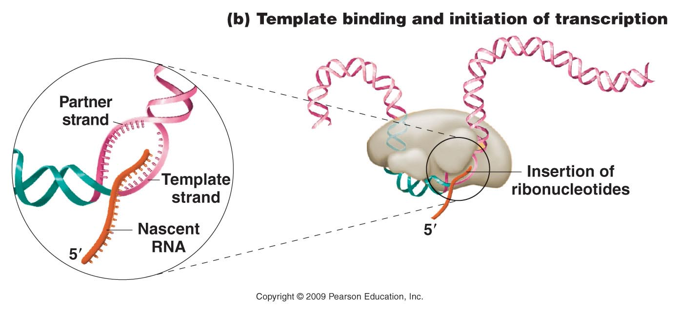
Figure 13.9b
Notes:
Figure 14-9b The early stages of transcription in prokaryotes, showing (a) the components of the process; (b) template binding at the –10 site involving the sigma subunit of RNA polymerase and subsequent initiation of RNA synthesis; and (c) chain elongation, after the sigma subunit has dissociated from the transcription complex and the enzyme moves along the DNA template.

Slide 28
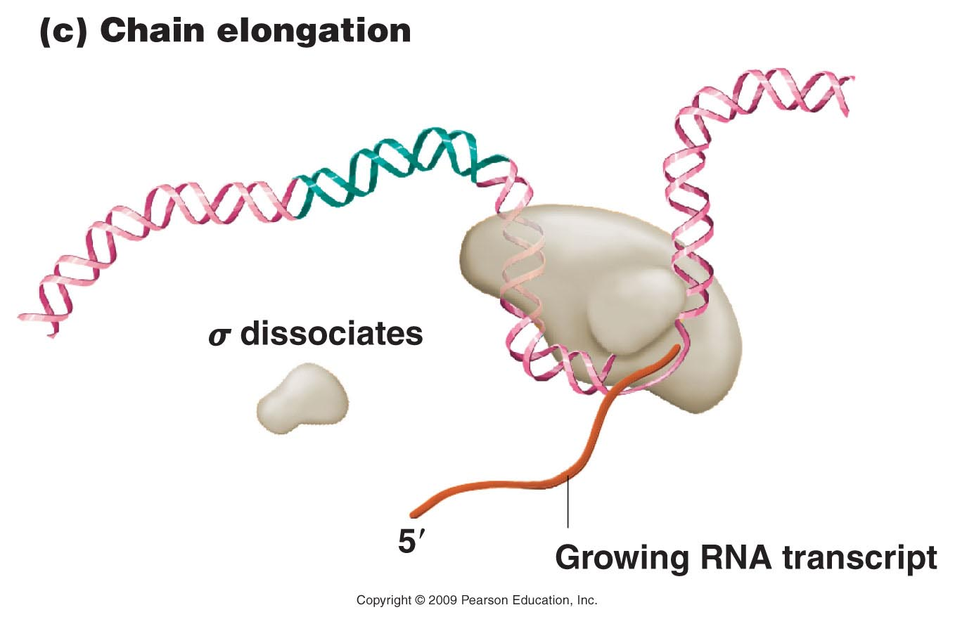
Figure 13.9c
Notes:
Figure 14-9c The early stages of transcription in prokaryotes, showing (a) the components of the process; (b) template binding at the –10 site involving the sigma subunit of RNA polymerase and subsequent initiation of RNA synthesis; and (c) chain elongation, after the sigma subunit has dissociated from the transcription complex and the enzyme moves along the DNA template.

Slide 29
Some good animations…
file:///Volumes/Klug_IRCD/Chapter_14/A_Prepared_PowerPoint_Tools/Animations_in_PowerPoint/14-1_7a_Transcription.htm
http://www.dnalc.org/resources/3d/12-transcription-basic.html

Slide 30
Transcription termination
In E. coli, RNA polymerase rides along the DNA, producing RNA until it encounters a nucleotide sequence called a terminator sequence.

Slide 31
“Consensus” sequence of terminator
Prokaryotic terminator sequences typically have a G-C rich 5’ region and a 3’ end that includes in a string of A nucleotides.
The terminator DNA sequence is about 40 nucleotides long and RNA polymerase transcribes the sequence into RNA.

Slide 33
DNA and RNA play a role in termination…
Near the end of the terminator, the RNA is complementary to a downstream region, and like many RNA sequences, can form intrastrand complementary base pairs.

Slide 34
Intrastrand base-pairing forms secondary structure in the RNA. The terminator forms a type of secondary structure sometimes called a hairpin, but which resembles this stem-loop.

Slide 36
How termination is thought to work…

Slide 37
Note---that the RNA itself assists in transcription termination. This is called intrinsic termination. No other factors are necessary.
Termination is especially important in prokaryotes because protein encoding genes are located so near each other!

Slide 38
Rho-dependent termination
Some E. coli genes cannot terminate with the terminator sequence alone. They require an additional protein factor.
The factor is called Rho (ρ)
Rho is thought to dislodge both RNApol and the new RNA from the DNA template

Slide 40
Depending on the gene, many rounds of transcription will occur is succession so many molecules of RNA are formed from the same gene.
(See picture at beginning of chapter 13)

Slide 42
Transcription tree---be sure to understand what each part represents

